Slide 1
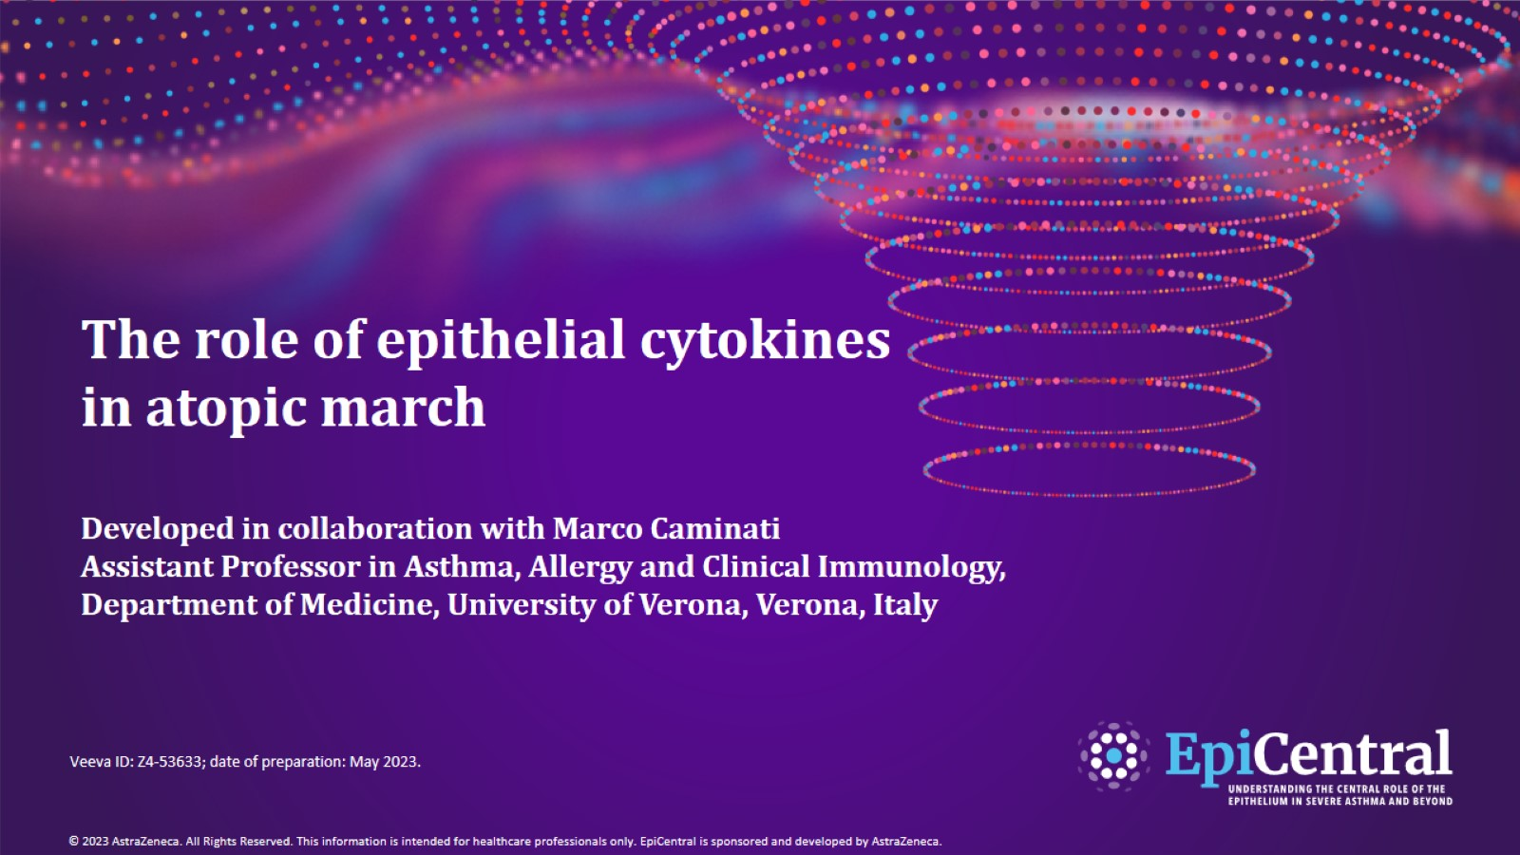
The role of epithelial cytokines in atopic march
Developed in collaboration with Marco Caminati
Assistant Professor in Asthma, Allergy and Clinical Immunology, Department of Medicine, University of Verona, Verona, Italy

Slide 2
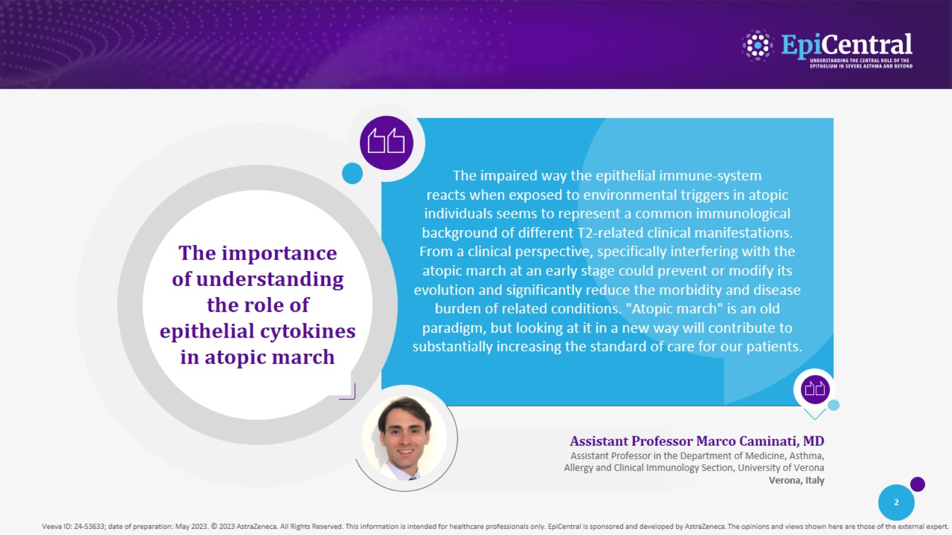

Slide 3
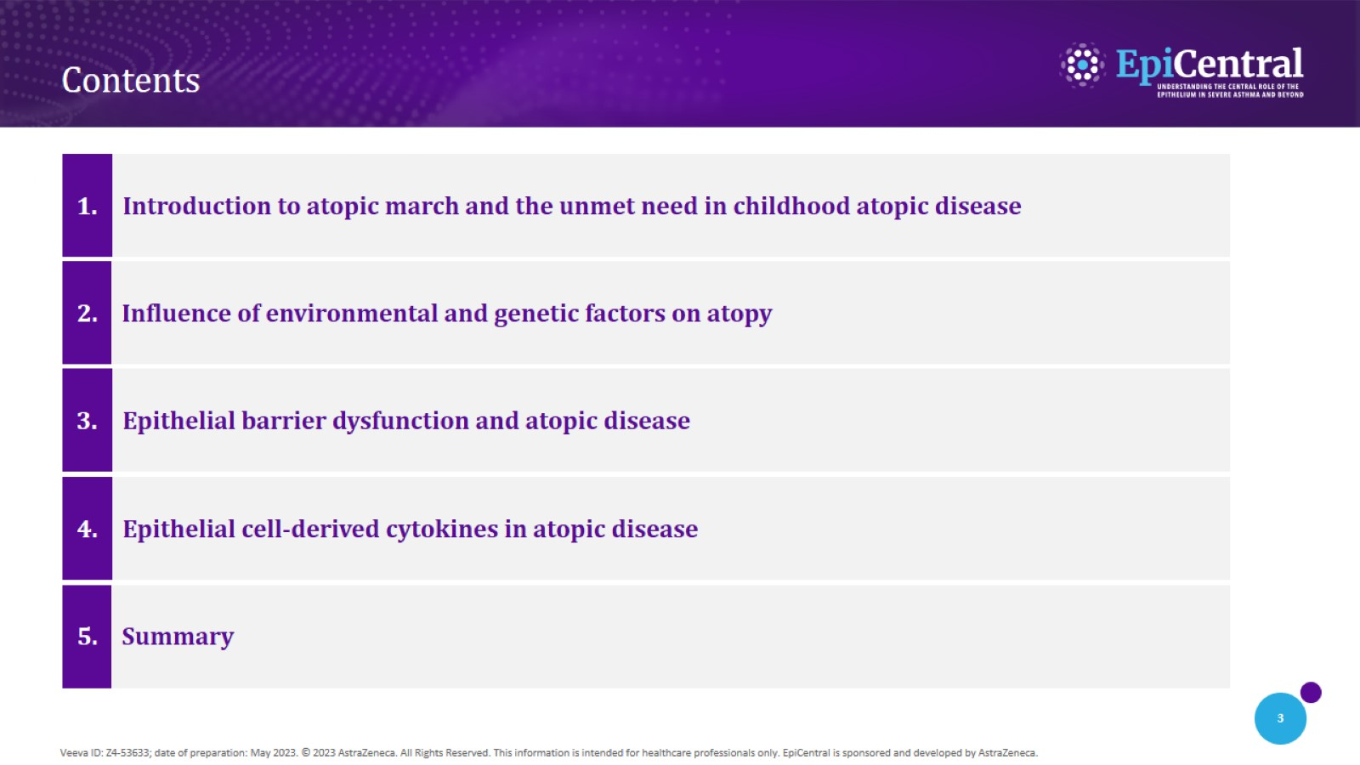
Contents

Slide 4
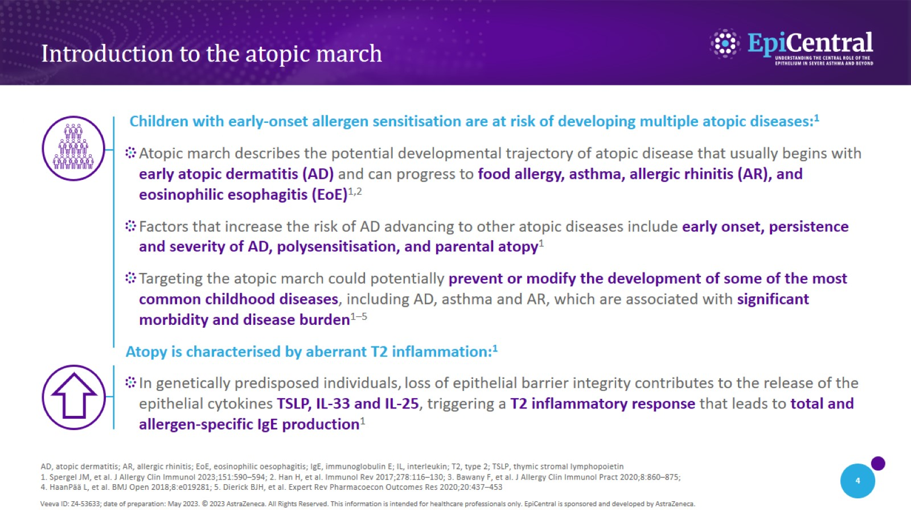
Introduction to the atopic march

Slide 5
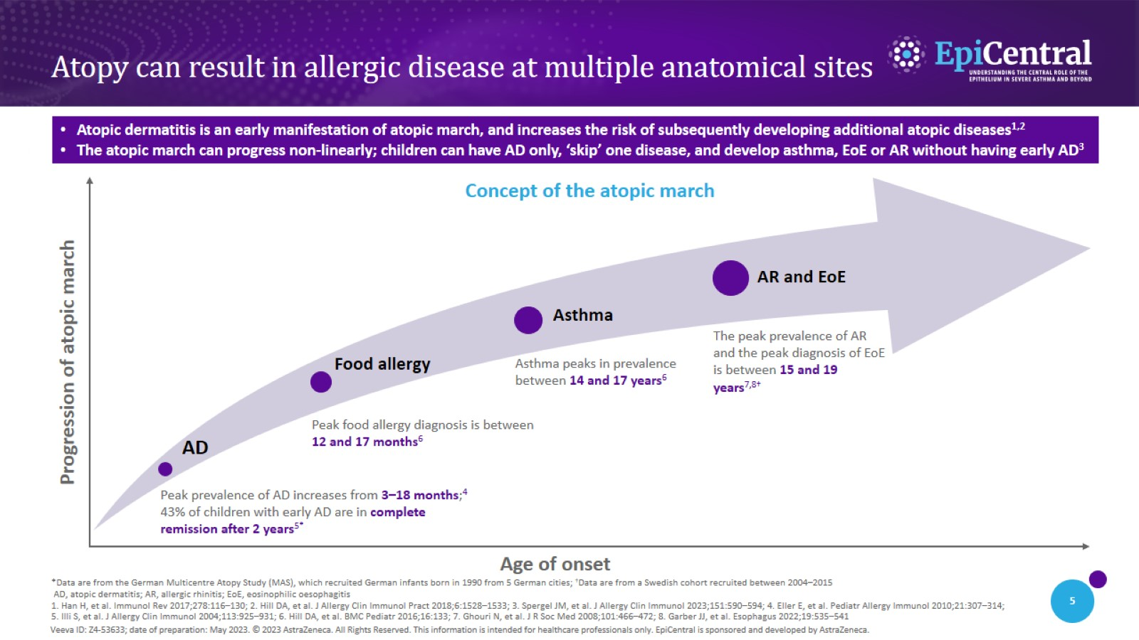
Atopy can result in allergic disease at multiple anatomical sites

Slide 6
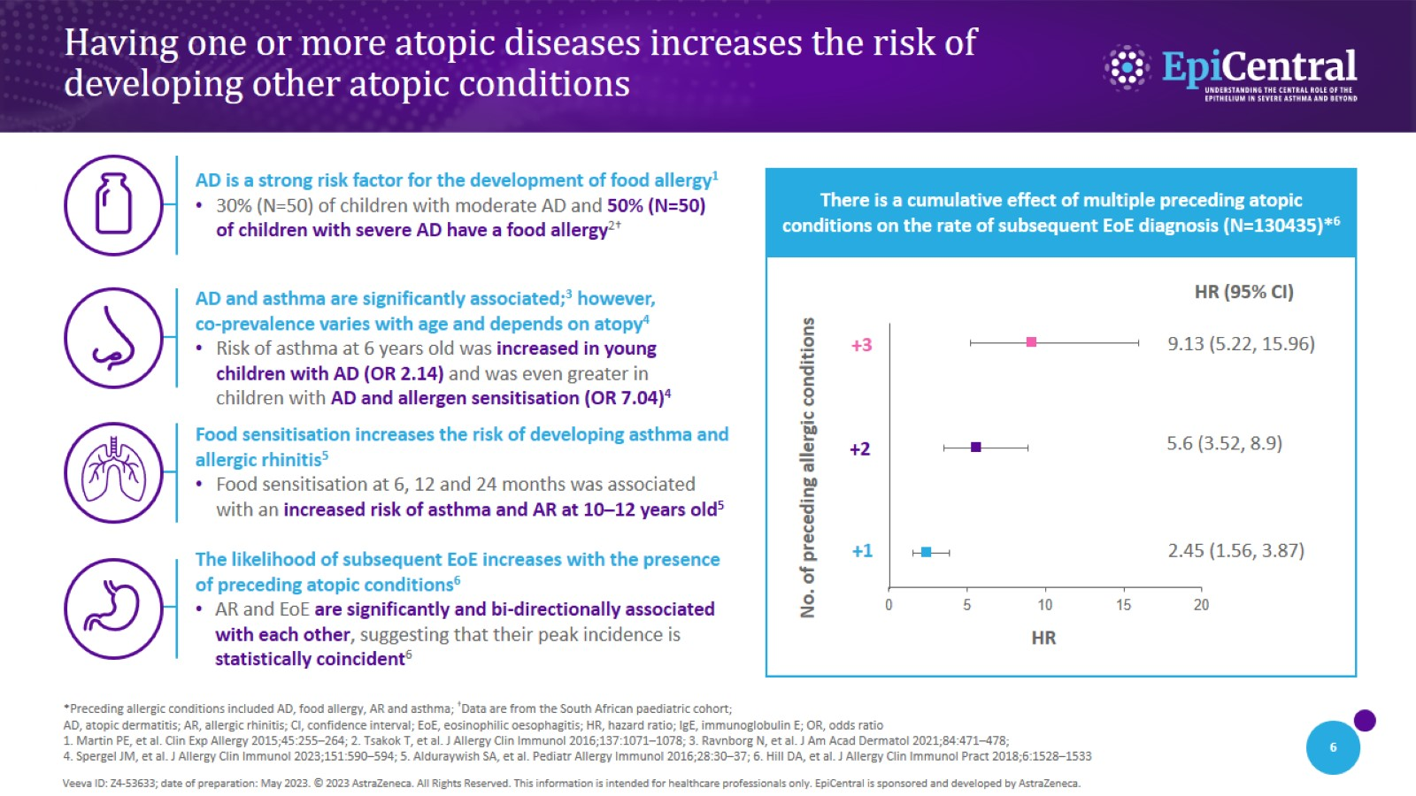
Having one or more atopic diseases increases the risk of developing other atopic conditions

Slide 7
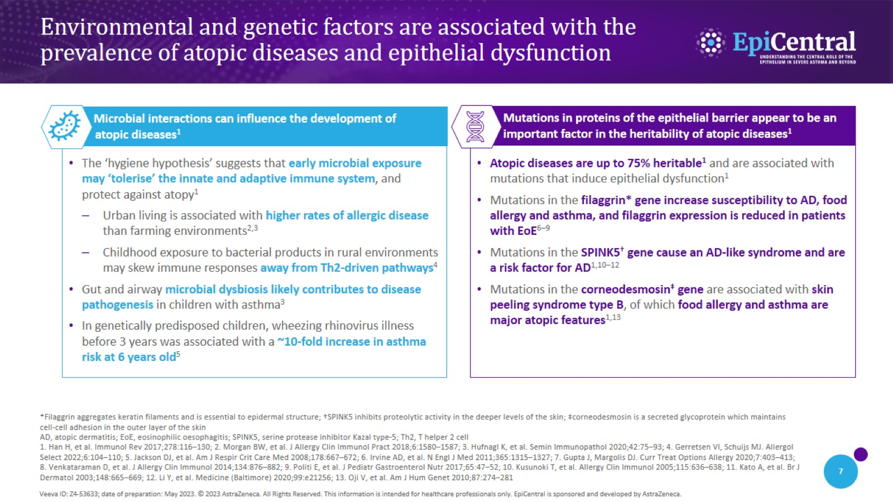
Environmental and genetic factors are associated with the prevalence of atopic diseases and epithelial dysfunction

Slide 8
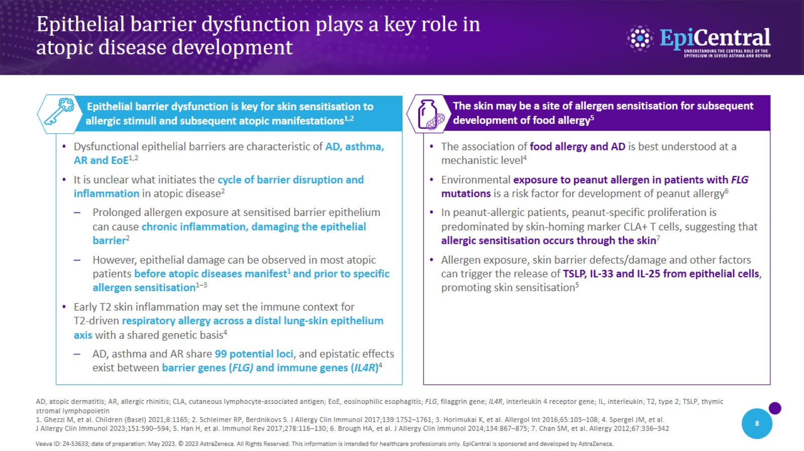
Epithelial barrier dysfunction plays a key role in atopic disease development

Slide 9
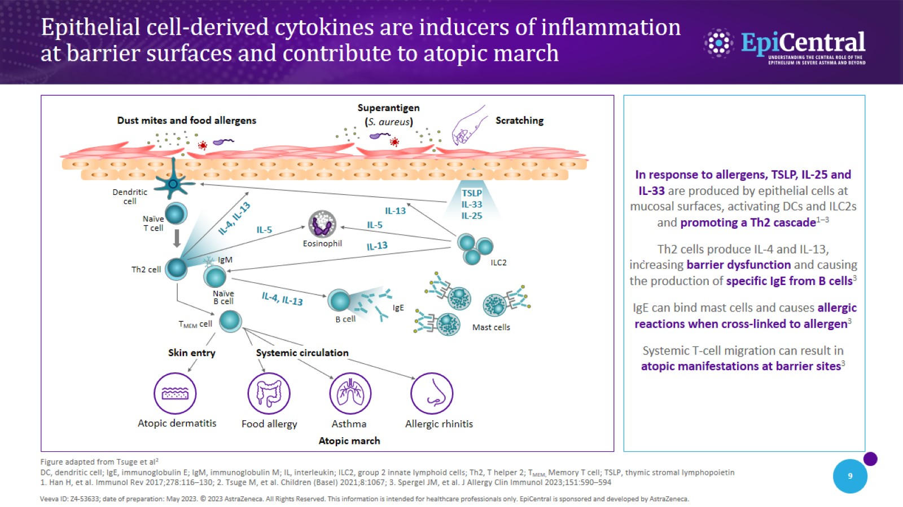
Epithelial cell-derived cytokines are inducers of inflammation at barrier surfaces and contribute to atopic march

Slide 10
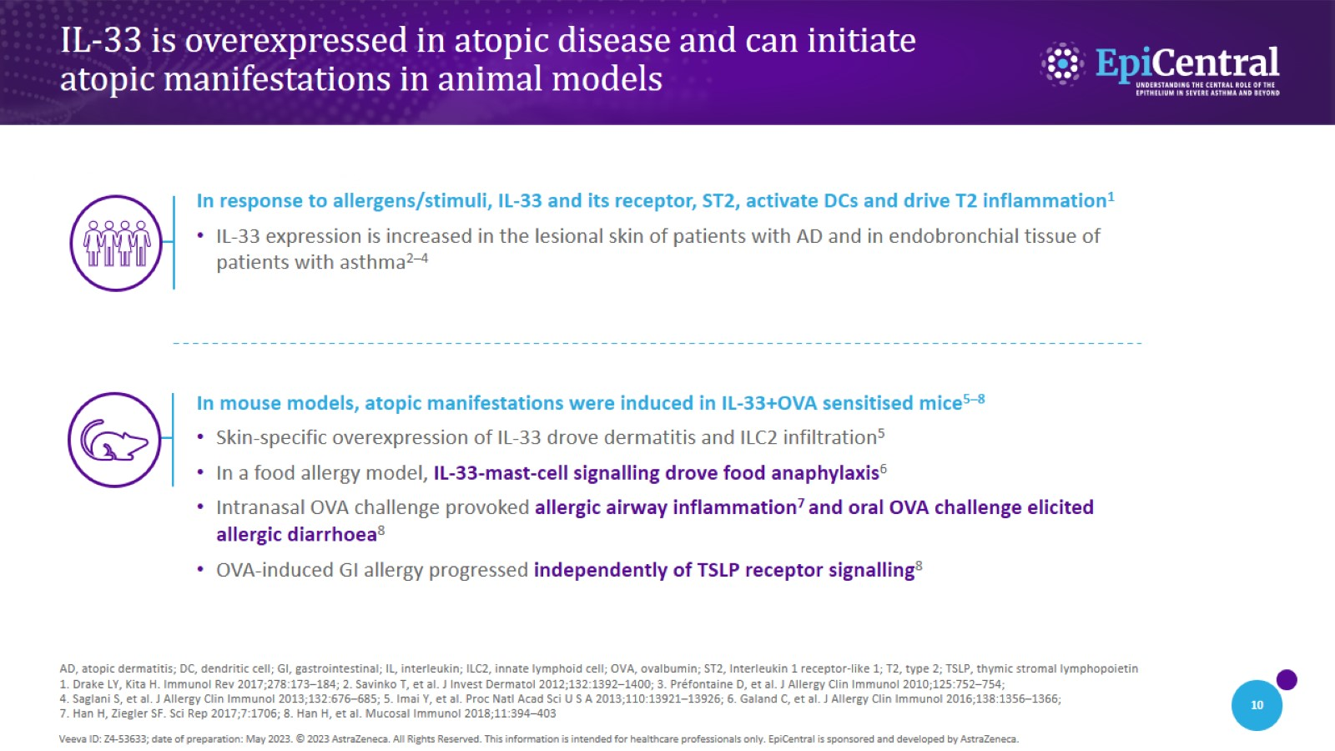
IL-33 is overexpressed in atopic disease and can initiate atopic manifestations in animal models

Slide 11
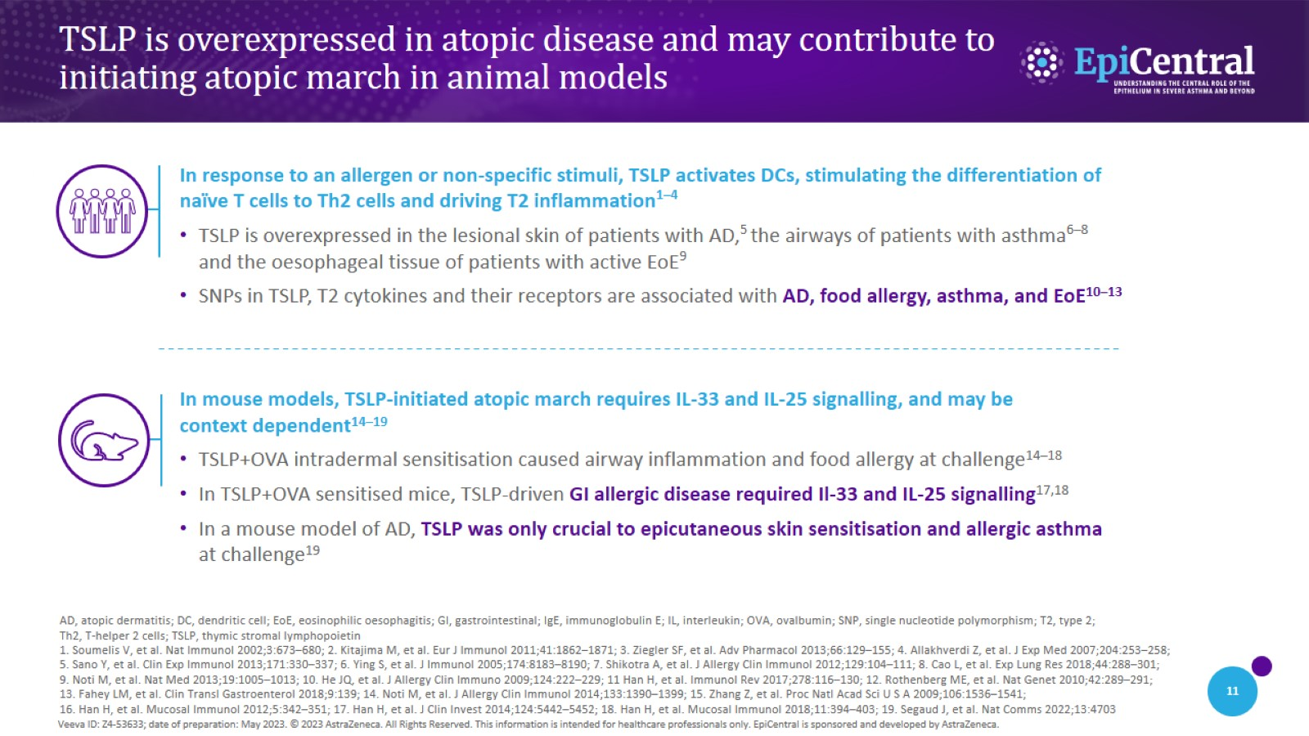
TSLP is overexpressed in atopic disease and may contribute to initiating atopic march in animal models

Slide 12
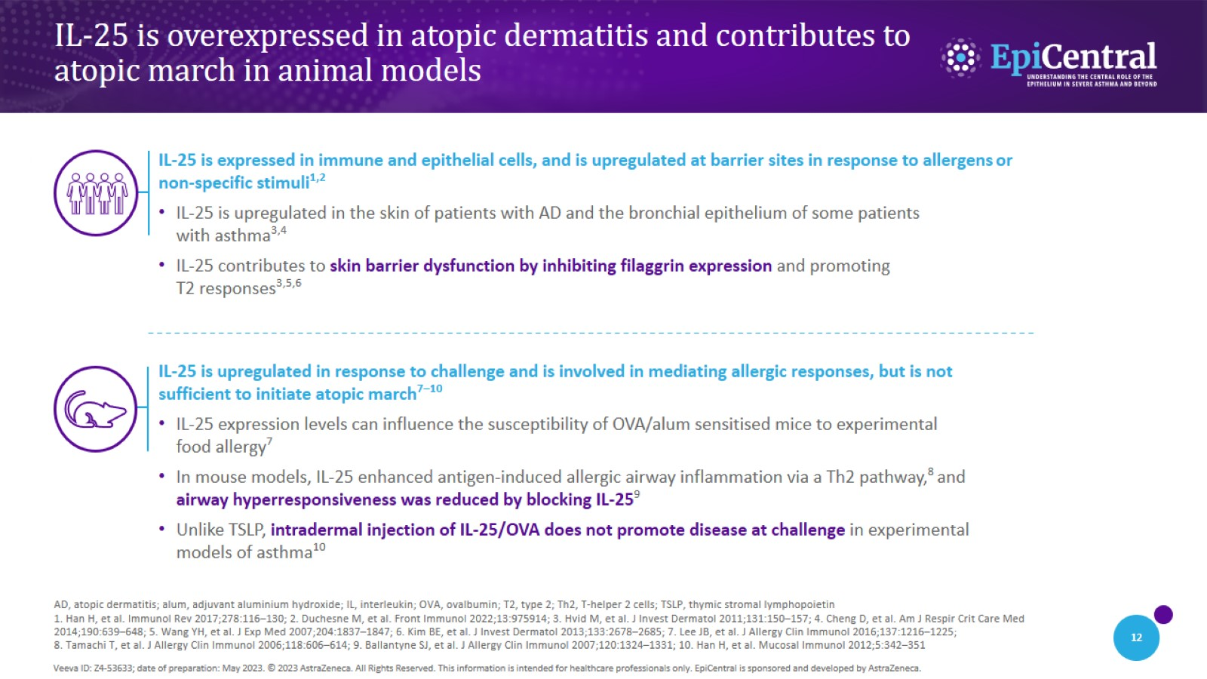
IL-25 is overexpressed in atopic dermatitis and contributes to atopic march in animal models

Slide 13
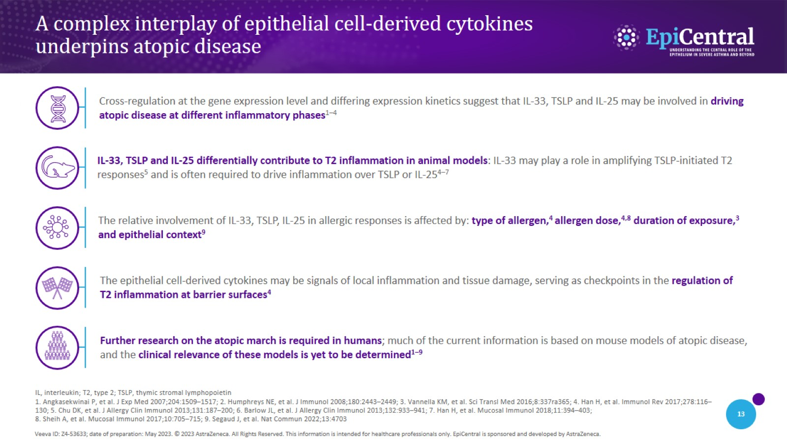
A complex interplay of epithelial cell-derived cytokines underpins atopic disease

Slide 14
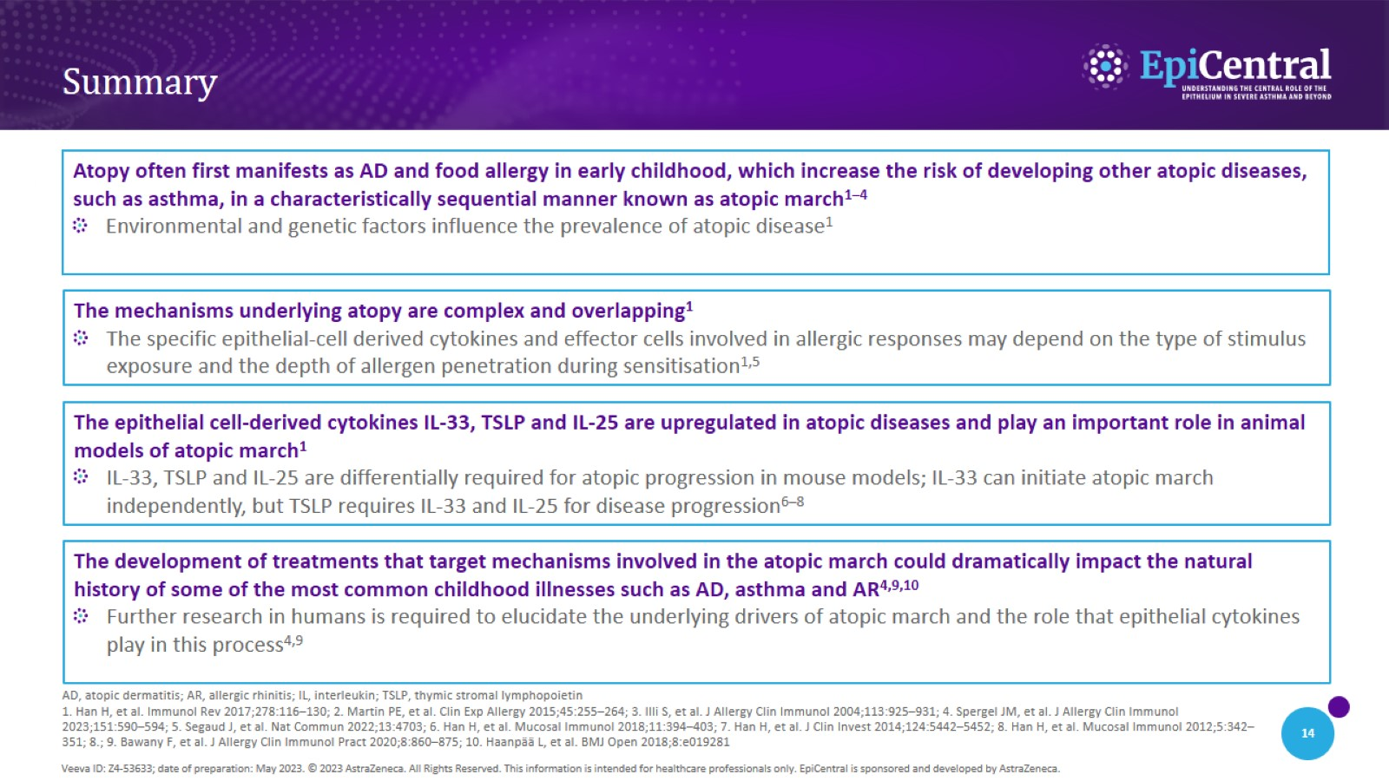
Summary

